Slide 1
Software Engineering Software Architecture
CS 1530
Spring 2020
Instructor: Sohel Sarwar
University of Pittsburgh
Lecture 7

Slide 2


Architectural Patterns

Slide 3
Architecture is the fundamental organization of a system embodied in its components, their relationships to each other, and to the environment, and the principles guiding its design and evolution. [IEEE 1471]
A system is a collection of components organized to accomplish a specific function or set of functions. The term system encompasses individual applications, systems in the traditional sense, subsystems, systems of systems, product lines, product families, whole enterprises, and other aggregations of interest. A system exists to fulfill one or more missions in its environment. [IEEE 1471]

Slide 4
An architectural pattern is a high level general reusable solution that focuses on system scalability, manageability, expandability, performance, availability, fault tolerance, etc.

Slide 5
View & Viewpoint
View: a representation of a whole system from the perspective of a related set of concerns.
Viewpoint: A viewpoint establishes the purposes and audience for a view and the techniques or methods employed in constructing a view.

Slide 6

System Architecture 4+1 View
4+1 is a view model designed by Philippe Kruchten for "describing the architecture of software-intensive systems, based on the use of multiple, concurrent views".
The views are used to describe the system from the viewpoint of different stakeholders, such as end-users, developers and project managers.
The four views of the model are logical, development, process and physical view. In addition selected use cases or scenarios are used to illustrate the architecture serving as the 'plus one' view. Hence the model contains 4+1 views.

Slide 7
Kruchten’s 4+1 view model
Modeling a system’s architecture
Viewer/User: End-users
Viewpoint: functionality
Viewer/User: Programmers
Viewpoint: Software Management
Logical
view
implementation
view
Use Case View
Viewer: All Stakeholders
Viewpoint: All actionable items
process
view
deployment
view
Viewer/User: Integrators
Viewpoint: performance, scalability, throughput
Viewer/User: System Engineers
Viewpoint: System topology, distribution, delivery, installation

Slide 8
4 + 1: Logical Viewpoint
The logical viewpoint supports the functional requirements, i.e., the services the system should provide to its end users.
Typically, it shows the key abstractions (e.g., classes and interactions amongst them).
Notes:
The logical view primarily supports the functional requirements; the services the system should provide to its end users.It depicts the major design elements and their interaction.
Designers decompose the system into a set of key abstractions, taken mainly from the problem domain. These abstractions are objects or object classes that exploit the principles of abstraction, encapsulation, and inheritance. In addition to aiding functional analysis, decomposition identifies mechanisms and design elements that are common across the system.
Components are related by “shares data with”
In termen van het boek is dit een module view

Slide 9
4 + 1: Process Viewpoint
The Process Viewpoint Addresses concurrent aspects at runtime (tasks, threads, processes and their interactions)
It takes into account of some nonfunctional requirements, such as performance, system availability, concurrency and distribution, system integrity, and fault-tolerance.
Notes:
The process view takes into account some nonfunctional requirements, such as performance and system availability. It addresses concurrency and distribution, system integrity, and fault-tolerance. The process view also specifies which thread of control executes each operation of each class identified in the logical view.
So the process view describes the mapping of functions to runtime elements. It concenrs the dynamics of the system. A process is a group of tasks which form a logical unit. A process can be started, stopped, resumed, etc., and there is communication between processes.
Components are related by “synchronizes with”
In termen van het boek: een C&C view

Slide 10
4 + 1: Deployment Viewpoint
The deployment viewpoint defines how the various elements identified in the logical, process, and implementation viewpoints-networks, processes, tasks, and objects-must be mapped onto the various nodes.
It takes into account of the system's nonfunctional requirements such as system availability, reliability (fault-tolerance), performance (throughput), and scalability.
Notes:
The physical view takes into account the system's nonfunctional requirements such as system availability, reliability (fault-tolerance), performance (throughput), and scalability. The software executes on a network of computers (the processing nodes). The various elements identified in the logical, process, and development views-networks, processes, tasks, and objects-must be mapped onto the various nodes. Several different physical configurations will be used-some for development and testing, others for system deployment at various sites or for different customers. The mapping of the software to the nodes must therefore be highly flexible and have a minimal impact on the source code itself.
Components are related by “communicates with”
In termen van het boek: een allocation view

Slide 11
4 + 1: Implementation Viewpoint
The imlementation viewpoint focuses on the organization of the actual software modules in the software-development environment.
The software is packaged in small chunks-program libraries or subsystems-that can be developed by one or more developers.
Notes:
The development view focuses on the organization of the actual software modules in the software-development environment. The software is packaged in small chunks-program libraries or subsystems-that can be developed by one or more developers. The subsystems are organized in a hierarchy of layers, each layer providing a narrow and well-defined interface to the layers above it.
Components are related by “is submodule of”.
In termen van het boek: een allocation view

Slide 12
4 + 1: Scenario Viewpoint
The scenario viewpoint consists of a small subset of important scenarios (e.g., use cases) to show that the elements of the four viewpoints work together seamlessly.
This viewpoint is redundant with the other ones (hence the "+1"), but it plays two critical roles:
it acts as a driver to help designers discover architectural elements during the architecture design;
it validates and illustrates the architecture design, both on paper and as the starting point for the tests of an architectural prototype.
Notes:
The scenario view consists of a small subset of important scenarios-instances of use cases-to show that the elements of the four views work together seamlessly. For each scenario, we describe the corresponding scripts (sequences of interactions between objects and between processes). This view is redundant with the other ones (hence the "+1"), but it plays two critical roles:
it acts as a driver to help designers discover architectural elements during the architecture design;
it validates and illustrates the architecture design, both on paper and as the starting point for the tests of an architectural prototype.
The scenario view is important for stakeholder communication.

Slide 13
System Architecture 4+1 View
Logical view: The logical view is concerned with the functionality that the system provides to end-users. UML diagrams used to represent the logical view include, class diagrams, and state diagrams.
Process view: The process view deals with the dynamic aspects of the system, explains the system processes and how they communicate, and focuses on the runtime behavior of the system. The process view addresses concurrency, distribution, integrators, performance, and scalability, etc. UML diagrams to represent process view include the activity diagram.

Slide 14
System Architecture 4+1 View
Development view: The development view illustrates a system from a programmer's perspective and is concerned with software management. This view is also known as the implementation view. It uses the UML Component diagram to describe system components. UML Diagrams used to represent the development view include the Package diagram.
Physical view: The physical view depicts the system from a system engineer's point of view. It is concerned with the topology of software components on the physical layer as well as the physical connections between these components. This view is also known as the deployment view. UML diagrams used to represent the physical view include the deployment diagram

Slide 15
System Architecture 4+1 View
Scenarios: The description of an architecture is illustrated using a small set of use cases, or scenarios, which become a fifth view. The scenarios describe sequences of interactions between objects and between processes. They are used to identify architectural elements and to illustrate and validate the architecture design. They also serve as a starting point for tests of an architecture prototype. This view is also known as the use case view.

Slide 16


Architectural Patterns
‘Notion’ of an architectural pattern is essential to good architectural design.
We call these architectural patterns or architectural styles.
Patterns provide for flexible systems using components
Components are as independent as possible. (Hunks of executable components…)
Some architectural patterns are better far better for some applications than for others.
Let’s look at a few important ones.

Slide 17

Architectural Patterns
Multi Layered
Multi Tiered
Client-Server
Broker
Pipe & Filter
MVC

Slide 18
Architectural Patterns
Blackboard system
Event-driven architecture
Implicit invocation
Service Oriented Architecture
Microservices

Slide 19

The Multi-Layer Architectural Pattern
Layered architecture:
Layers are cohesive within themselves; but have very low coupling with each other.
Layers communicate with adjacent layers in a sequential manner
Normally no layers are skipped, but under extraordinary condition a certain layer can be skipped.
It is a classical approach.
The higher layer sees the lower layers as a set of services and this notion is fundamental to good design.
Information flow is bidirectional.
The infrastructure is Localized.

Slide 20
Multi-Layered Architectural Pattern…
Built with layers at increasing levels of abstraction.
1. User Interface layer - normally first for presentation
2. Application Layer is usually immediately below UI layer and typically provides the application functions determined by application use-cases. (application layer)
3. Domain Layer is usually next and provides general domain-level services (business use-cases)
4. Services / Support (Bottom) layers provide general (but essential) services.
e.g. network communication, database access
operating system services

Slide 21
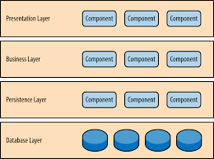
Multi-Layered Architectural Pattern…

Slide 22
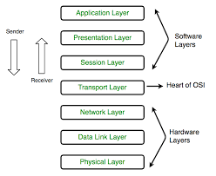
Multi-Layered Architectural Pattern…

Slide 23
Extremely Nice Feature of Layered Design
Layers / layer services are replaceable
NO impacting to other layers and dependencies
if the interfaces remains unchanged.
Examples:
User Interface layer when porting to a different platform or for different environments.
Upgrading / enhancing / optimizing services…
We have clear separation of concerns
We have very good ‘cohesion’ of services…

Slide 24
Multi-Layered Architectural Pattern…
Example Of Multi-layer Systems (Seen Before…)
Application programs
Screen display
facilities
Dealing with
application protocols
User account
User
management
Dealing with
interface
connections
File
Application
system
Dealing with
logic
packets
Kernel
Operating system
Database
Network
(handling processes
Transmitting
access
access
communication
and swapping)
and receiving
a) Typical layers in an
b) Typical layers in an
c) Simplified view of layers
application program
operating system
in a communication system
Communications between layers: usually use procedure calls. Upper layers become clients; lower layers become servers.

Slide 25
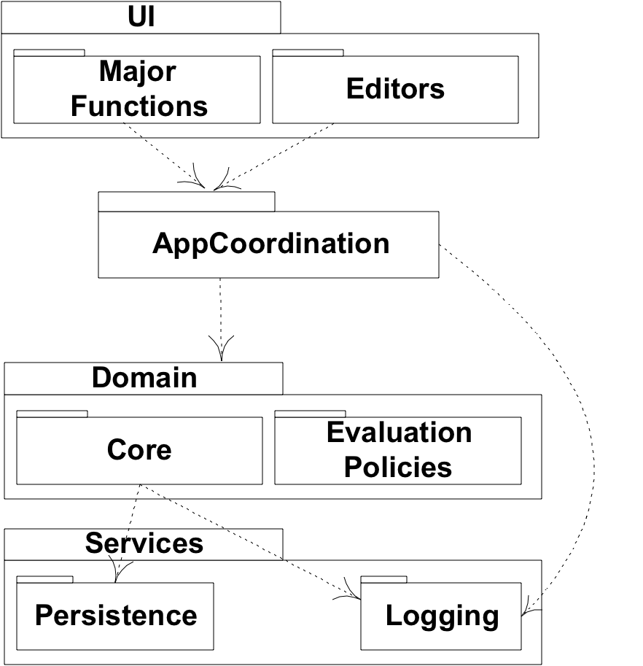
Multi-Tier Architectural Pattern…
Multi-Tier Architecture

Slide 26
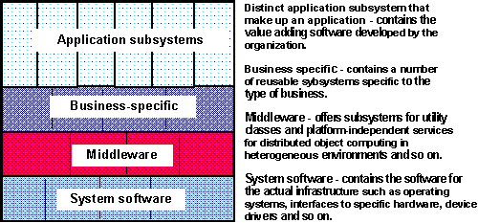
Multi-Tier Architectural Pattern…
Multi-Tier Architecture
Specific functionality
General functionality
This is a very broad generalization. in practice, things will be
considerably different and application dependent in many cases.
Note: this is also a very general view; may/may not include a GUI layer.

Slide 27
Multi-Tier Architectural Pattern…
Multi-Tier Architecture
Separate presentation and application logic, and other areas of concern.
Consider: Different names (in some cases). Can see the main idea!
UI Tier (or Front Tier)
(Interface may/may not be graphical…)
“Domain” or “Application Logic” or Middle Tier
(May/may not need both…)
Extended Middle Services Tier
Persistence
Subsystem
Logging
Subsystem
Security
Subsystem
DataTier

Slide 28

Multi-Tiered Architecture:
Tiers are cohesive within themselves; but have very low coupling with each other.
Tiers communicate with adjacent layers in a sequential manner
Normally no tiers skipped, but under extraordinary condition a certain layer can be skipped.
It is a classical approach.
The higher layer sees the lower layers as a set of services and this notion is fundamental to good design.
Information flow is bidirectional.
The infrastructure is distributed.

Slide 29
Multi Layered or Tiered Architecture And Design Principle Satisfy Eleven Architectural Design Principles)
1. Divide and conquer: layers/tiers can be independently designed.
2. Increase cohesion: Well-designed layers/tiers have layer/tier cohesion.
3. Reduce coupling: Well-designed lower layers do not know about the higher layers or other tiers and the only connection between layers is through the API.
4. Increase abstraction: you do not need to know the details of how the lower layers or other tiers are implemented.
5. Increase reusability: The lower layers or tiers can often be designed generically. (e.g. those that handle database access, persistency, etc.) (different databases….)

Slide 30
Multi-layered or Tiered Architecture And Design Principle Satisfy Eleven Architectural Design Principles)*
6. Increase flexibility: you can add new facilities built on lower-level services, or replace higher-level layers.
7. Anticipate obsolescence: By isolating components in separate layers, the system becomes more resistant to obsolescence.
8. Design for portability: All the dependent facilities can be isolated in one of the lower layers.
9. As we know, some things tend to change over time; more than some other aspects of an application.

Slide 31
Multi-layered Architecture And Design Principle Satisfy Eleven Architectural Design Principles)*
10. Design for testability: Layers can be tested independently through the interfaces exercising layer responsibilities.
11. Design defensively: The APIs of layers are natural places to build in rigorous assertion-checking.
Note that this model appears to satisfy all eleven design principles!

Slide 32
Client-server and other Distributed Architectural Patterns
At least one component has the role of server:
waiting for and then handling connections.
At least one component that has the role of client, initiating connections to obtain some service.
Three-tier model for web-based client-sever applications:
Server ‘in the middle’
server to client (web-based or not; likely communicating via the Internet)
client to a database server (usually / often via an intranet)

Slide 33
Other Distributed Client-server Architectural Patterns
Peer-to-Peer pattern. A system where:
various software components distributed over several hosts.
Hosts: both clients and servers (to each other)
Any two components can set up a communications channel through which communications is accomplished.
Variation:
Sometimes peers need to be able to find each other;
May need a server containing location information

Slide 34
An Example Of A Distributed System
Client1:
<<communication>>
look up addresses
<<communication>>
exchange messages
<<communication>>
Server:
exchange messages
Client2:
<<communication>>
<<communication>>
look up addresses
exchange messages
Client3:

Slide 35
How Does The Client-server Architectural Pattern Subscribe To Principles Of Good Architectural Design?
1. Divide and conquer: Dividing the system into client and server processes is a strong way to divide the system.
➔ Each can be separately developed.
2. Increase cohesion: Server can each provide cohesive services to clients.
3. Reduce coupling: There is usually only one communication channel exchanging simple messages.
4. Increase abstraction: Separate distributed components are often good abstractions. What does this sentence mean to you? Abstractions??
6. Increase reuse: It is often possible to find suitable frameworks on which to build good distributed systems. Sample architectures already exist. However, client-server systems are often very application specific.

Slide 36
The Pipe-and-Filter Architectural Pattern
Streams of data, in a relatively simple format, passed through series of processes
Data constantly fed into a pipeline; Each component transforms the data in some way.
The processes work concurrently. Constant data in and coming out.
Information flow is unidirectional.
Very flexible architecture.
Almost all the components could be removed.
Components may added, changed, deleted, reordered…
Very flexible particularly (for example) as in converting data or filtering out (removing) characters or ‘features’, etc.
Sometimes (oftentimes) data might undergo a series of transformations…
The transformations can take place in both parallel and/or serial processes
Can also split pipelines or join pipelines together.

Slide 37

Pipe & Filter Architecture
One pipe starts here…
encoders for
microphones
Note the concurrency…
microphone
near
input
sound
source
Pipelines join here
cancel
cancel
remove
equalize
echo
noise
non-voice
dynamic
compress
transmit
frequencies
range
TCP/IP Transmission
encoder for
distant
ambient
encode
microphone
noise
speaker
decompress
receive
Another pipeline starts here…
output
Think in terms of manufacturing processes, process control applications
or a GPS system.
Used more frequently in scientific/engineering systems than in information
systems applications.
Note: questionable architecture for an information system….

Slide 38
Pipe-and-Filter Architecture: Design Principles
1. Divide and conquer: The separate processes can be independently designed. Excellent for manufacturing / process control / etc. systems.
2. Increase cohesion: The processes have functional cohesion. (single input; single output; no side effects…)
3. Reduce coupling: The processes have only one input and one output.

Slide 39
Pipe-and-Filter Architecture: Design Principles
4. Increase abstraction: The pipeline components are often good abstractions, hiding their internal details. And components are usually replacable!
5. Increase reusability: The processes can often be used in many different contexts.
6. Increase reuse: It is often possible to find reusable components to insert into a pipeline.

Slide 40
The Broker Architectural Pattern
Used to structure distributed systems
decouple components that interact by remote service invocations
Responsible for coordinating communication:
forwarding of requests from client to server
transmission of results and exceptions
Context: distributed, heterogeneous, with independent components environment

Slide 41
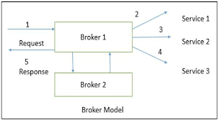
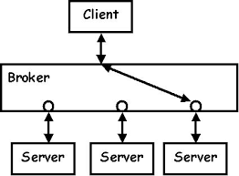
Broker Pattern Solution

Slide 42

The Broker Architectural Pattern Example
Very popular design pattern. Simple and very effective.
Note that all these architectural patterns are illustrated using ‘components.’

Slide 43
Broker Pattern solution
Design broker component to decouple clients from servers
Servers:
Register with broker
present method interfaces to clients
Clients
access server’s methods via broker
uses same form to call server’s methods

Slide 44
Broker Pattern Solution
Broker’s tasks
locating appropriate server
forwarding requests to server
transmitting results and exceptions to client

Slide 45
Broker Architectural Structure
Six types of participating components:
Clients
Servers
Brokers
Bridges
Client-side proxies
Server-side proxies

Slide 46
Broker Architectural Structure
Bridges: Layer between two brokers used to hide each side implementation details. In particular when a Broker system is run on a heterogeneous network, two brokers have to communicate independently of network and OS in use. Bridges encapsulate these system-specific details.

Slide 47
Broker Architectural Static Diagram
Broker
Client-side Proxy
Main_event_loop
update_repository
register-service
acknoledgment
find_server
find_client
forward_request
forward_response
Server-side Proxy
Pack_data
unpack_data
send request
return
Pack_data
unpack_data
call_service
send_response
Client
Server
Call_server
start_task
use_broker_API
Bridge
Initialize
register_service
enter_main_loop
run_service
use_broker_API
Pack_data
unpack_data
forward_message
transmit_message

Slide 48
Broker Benefits
Location transparency
Components changeability and extensibility
Broker system portability
Broker systems interoperability
Reusability

Slide 49
Broker Liabilities
Restricted efficiency due to indirection
Lower fault tolerance. May need object replication for higher fault tolerance.

Slide 50
The Model-View-Controller (MVC) Architectural Pattern
Architectural pattern to help separate user interface layer from other parts of the system
Great way to have layered cohesion.
Coupling reduced between UI layer and rest of system.
Very popular architectural pattern….
THE MVC pattern separates the
Model: the functional layer (business entities, ‘key
abstractions,’ the objects, relations, ...) from the
View: the user interface and the
Controller; the director / sequencer of the activities in response to the user.

Slide 51
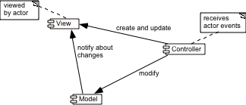
The Model-View-Controller (MVC) Architectural Pattern Example
MVC exhibits layered cohesion, as the model has no idea
what view and controller are attached to it (doesn’t care!).
Model is ‘passive’ in this respect.
The View (UI), business services (controller), and model
(business entities / core abstractions) will reside in different architectural layers.
Discuss the arrows…and their directions…
(from perspective of the
Controller…)
There may be special cases when no controller component is created, but
the separation of the model from the view is still essential.

Slide 52
The Model-View-Controller (MVC) Architectural Pattern Design Principles
1. Divide and conquer: Three components can be somewhat independently designed.
2. Increase cohesion: Components have stronger layer cohesion than if the view and controller were together in a single UI layer.
3. Reduce coupling: Minimal communication channels among the three components.
4. Increase reuse: The view and controller normally make extensive use of reusable components for various kinds of UI controls.
5. Design for flexibility: It is usually quite easy to change the UI by changing the view, the controller, or both.
6. Design for testability: Can test application separately from the UI.

